Slide 1
IMDb Ratings Prediction
ISTM 660 – Applied Predictive Analytics
Group 3: Priyanshu Porwal and Yash Saraiya

Slide 2
Agenda
Business Problem
Data Overview
Dataset Variables
Data Cleaning
Data Analysis
Descriptive Statistics
Data Visualization
Predictive Models
Training-Testing Split
Linear | KNN | Decision Tree | Random Forest
Model Comparison
Conclusion

Slide 3
Business Problem
In modern times, a movie's success depends on:
its box office collection
its perception in the public eye, i.e. public opinion
IMDb ratings indicate the quality of a movie and impact public opinion directly
Objective: To predict the IMDb ratings of a movie based on its features by applying advanced predictive modeling techniques

Slide 4
Data Overview
Source - IMDb movies extensive dataset (Kaggle)
Dataset last updated on - 01/01/2020
Total volume – 85000+ rows and 70+ columns
Size – 62.35 MB

Slide 5
Dataset Variables
IMDb movies.csv | IMDb ratings.csv
imdb_id: String title: String date published: Date country: String language: String actors: String director: String writer: String description: String avg_vote: numeric (Response) and 7 more.. | imdb_id: String total_votes: numeric Votes based on: Gender groups: numeric Age groups: numeric US and Non-US users: numeric Top 1000 users: numeric

Slide 6
Data Cleaning
Merged files to create a single repository
Format conversions: String to Date, String to Factor, etc.
Splitting lists to multiple columns for actors, directors, writers
Simplification of accent marks such as the acute accent, umlaut, etc.
Feature Engineering: Calculation of day of release, etc.
Conversion of NA values based on context
Data subsetting based on context

Slide 7
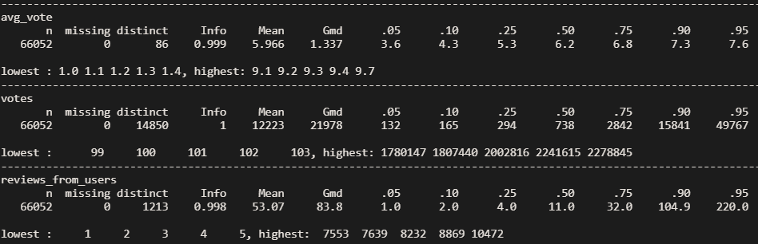
Data Analysis - Descriptive Statistics
Sample descriptive statistics for 3 columns: avg_vote, votes, reviews_from_users

Slide 8
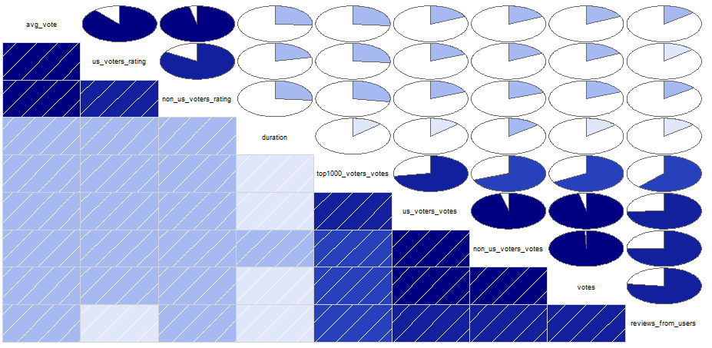
Data Analysis - Descriptive Statistics

Slide 9
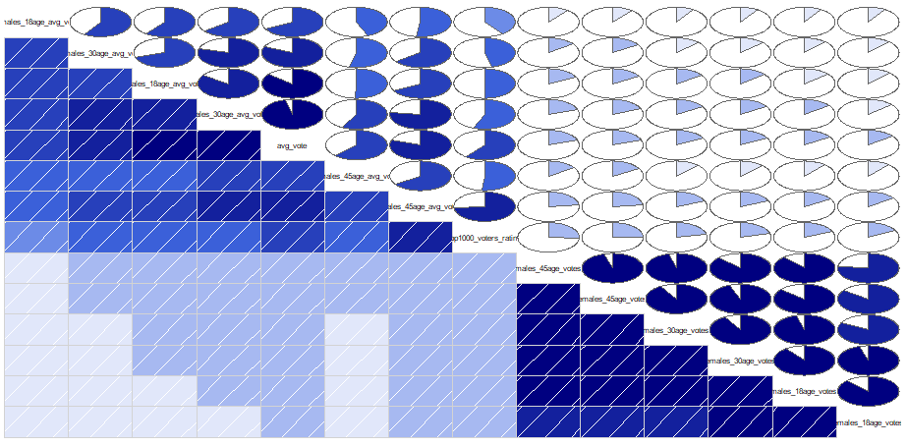
Data Analysis - Descriptive Statistics

Slide 10
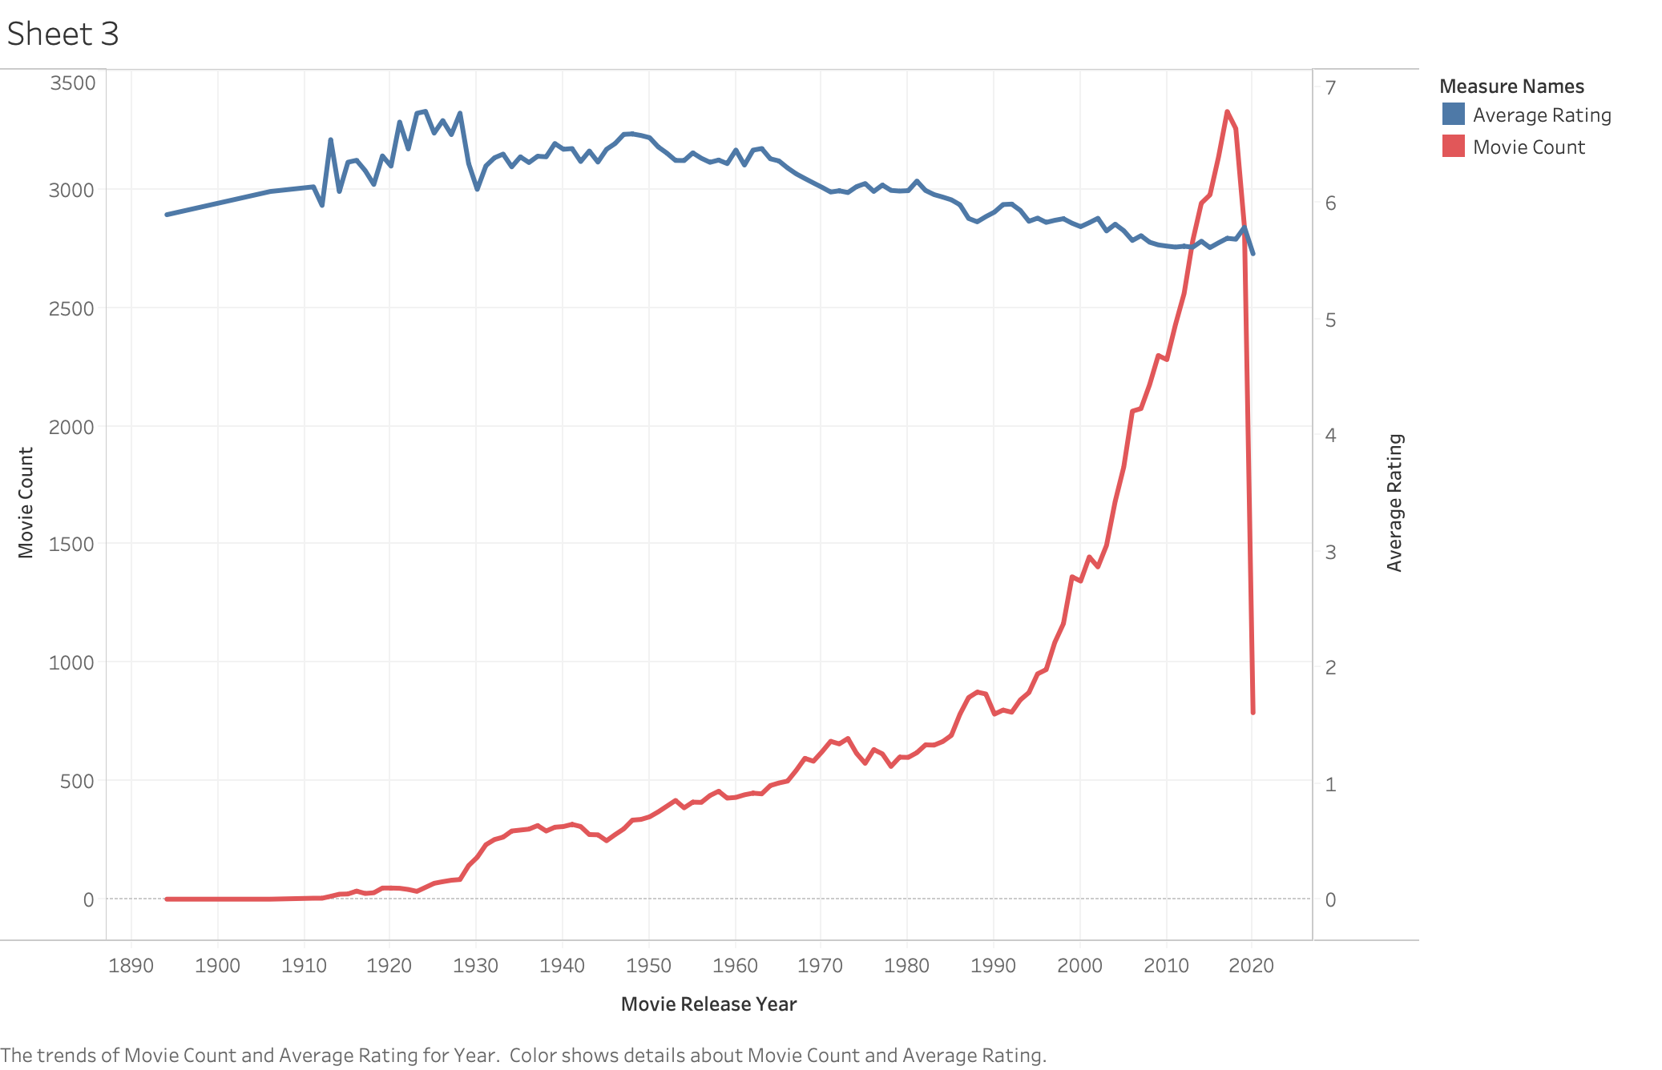
Trend in Average Rating based on Movie Release Year and Movie Count
Data Analysis - Data Visualization

Slide 11
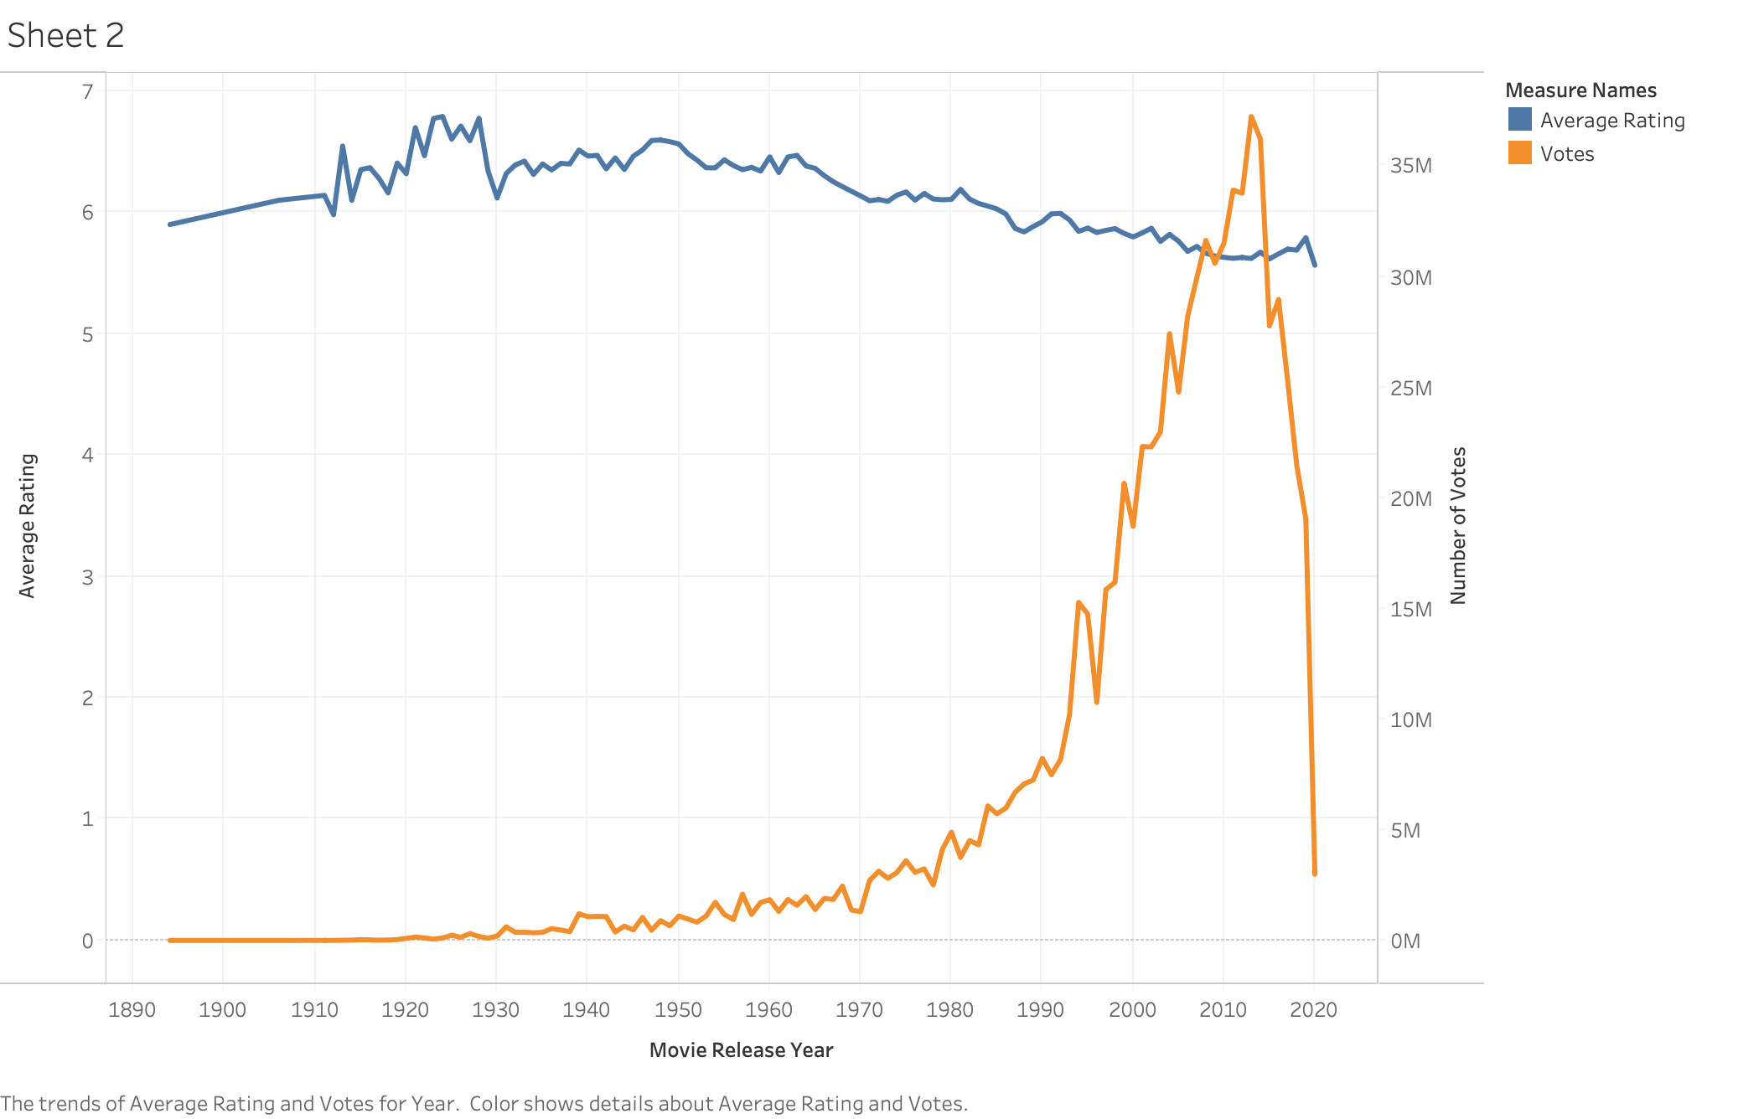
Data Analysis - Data Visualization
Trend in Average Rating based on Movie Release Year and Number of Votes

Slide 12
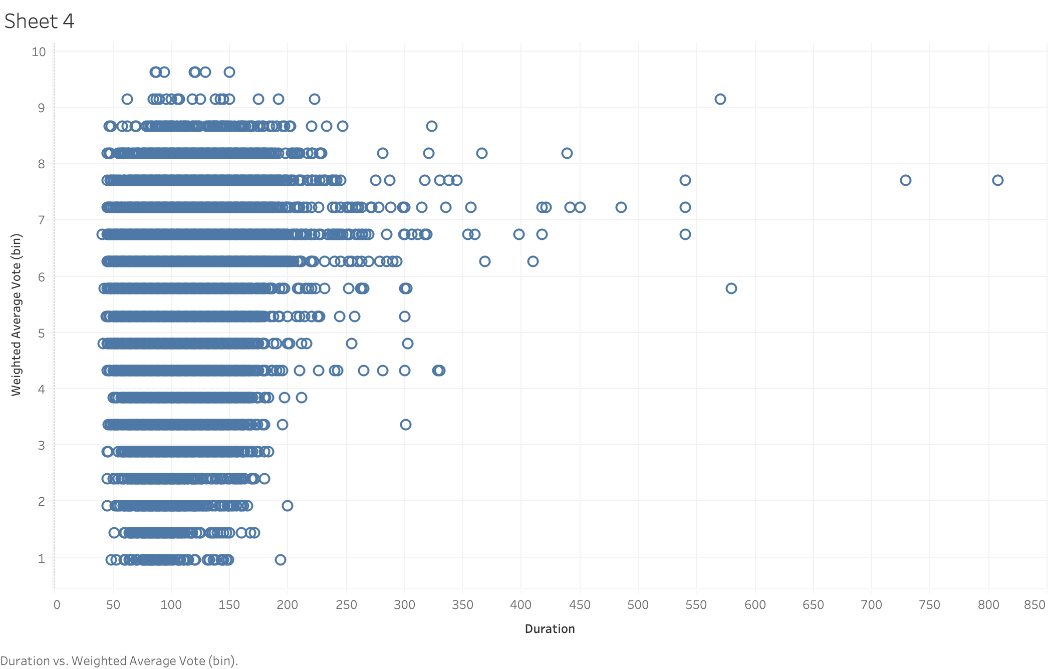
Data Analysis - Data Visualization
Movie Duration vs Average Vote Received

Slide 13
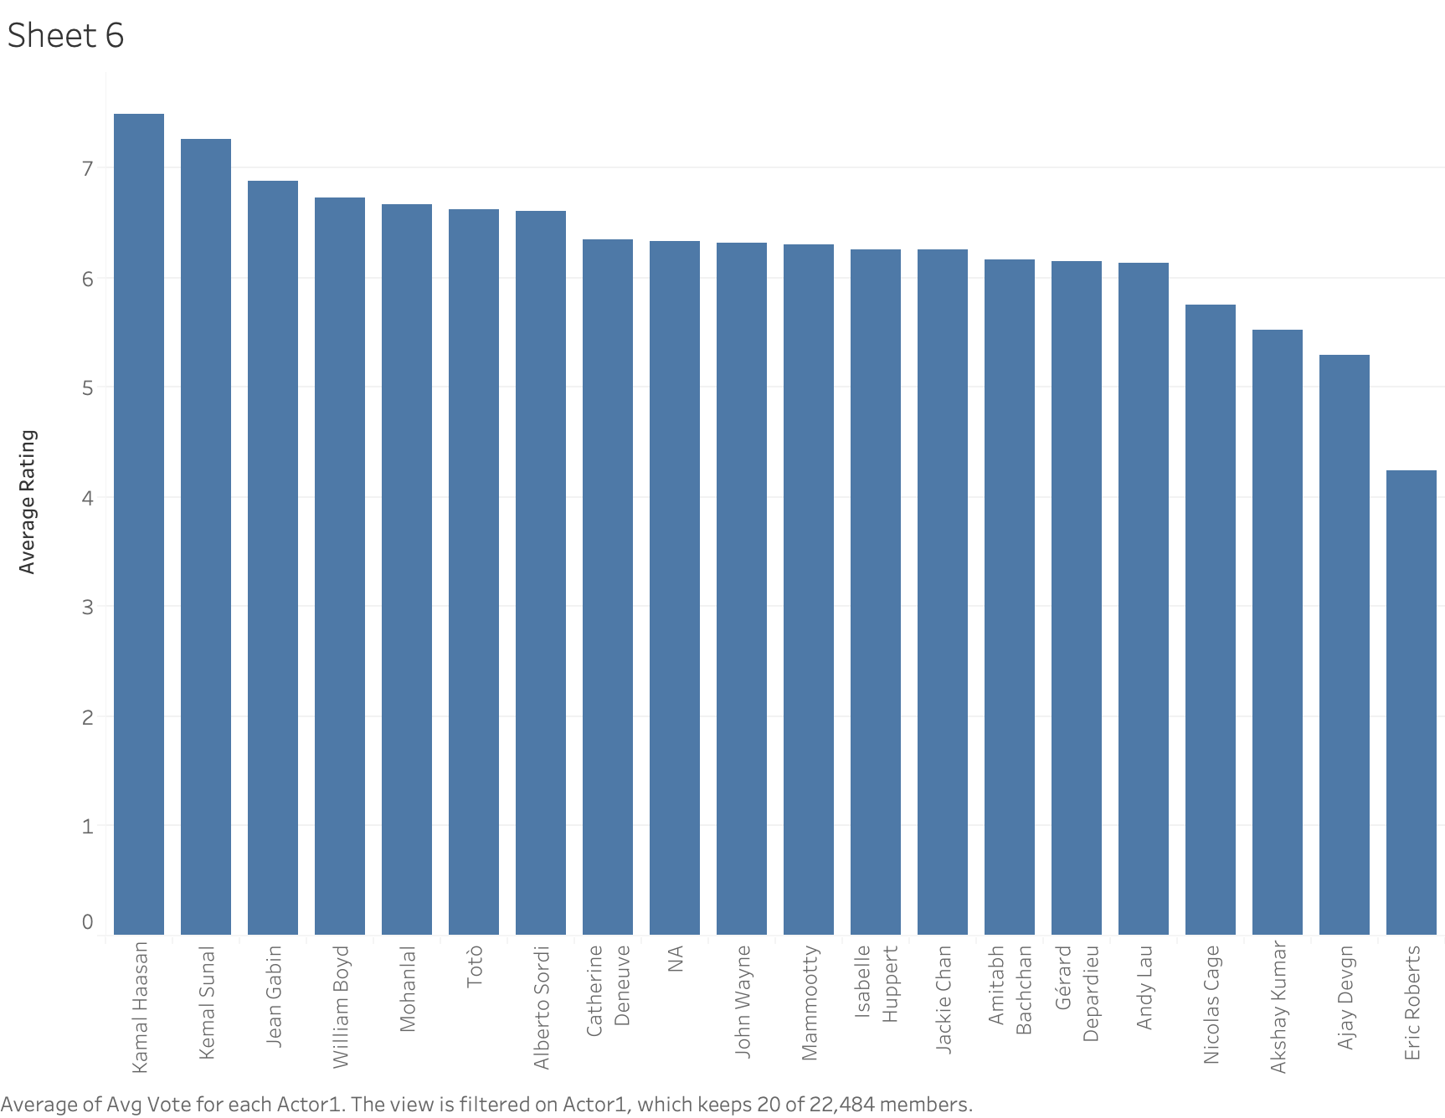
Data Analysis - Data Visualization
Average Rating for top 20 actors

Slide 14
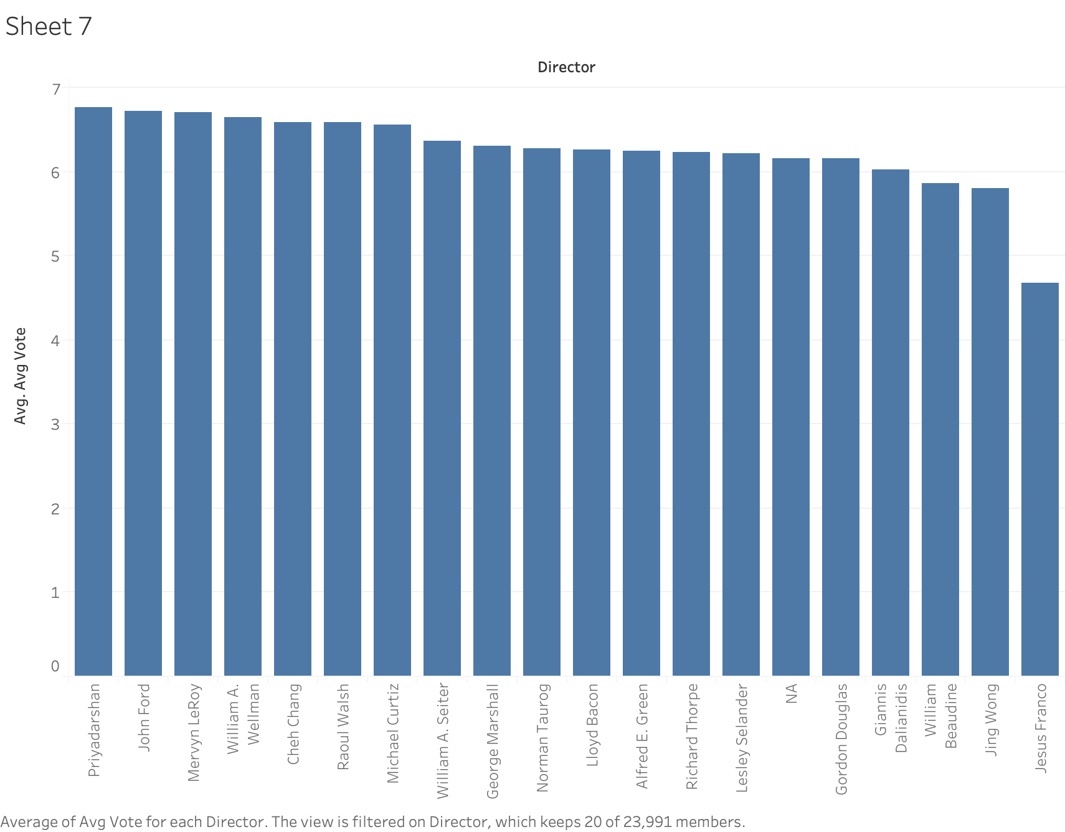
Data Analysis - Data Visualization
Average Rating for top 20 directors

Slide 15
Predictive Models – Training-Testing Split
To perform training and testing of models, the split was carried out in 75:25 fashion
Using 75% of data, models were trained and remaining 25% was used to test and compute Mean Squared Error during testing

Slide 16
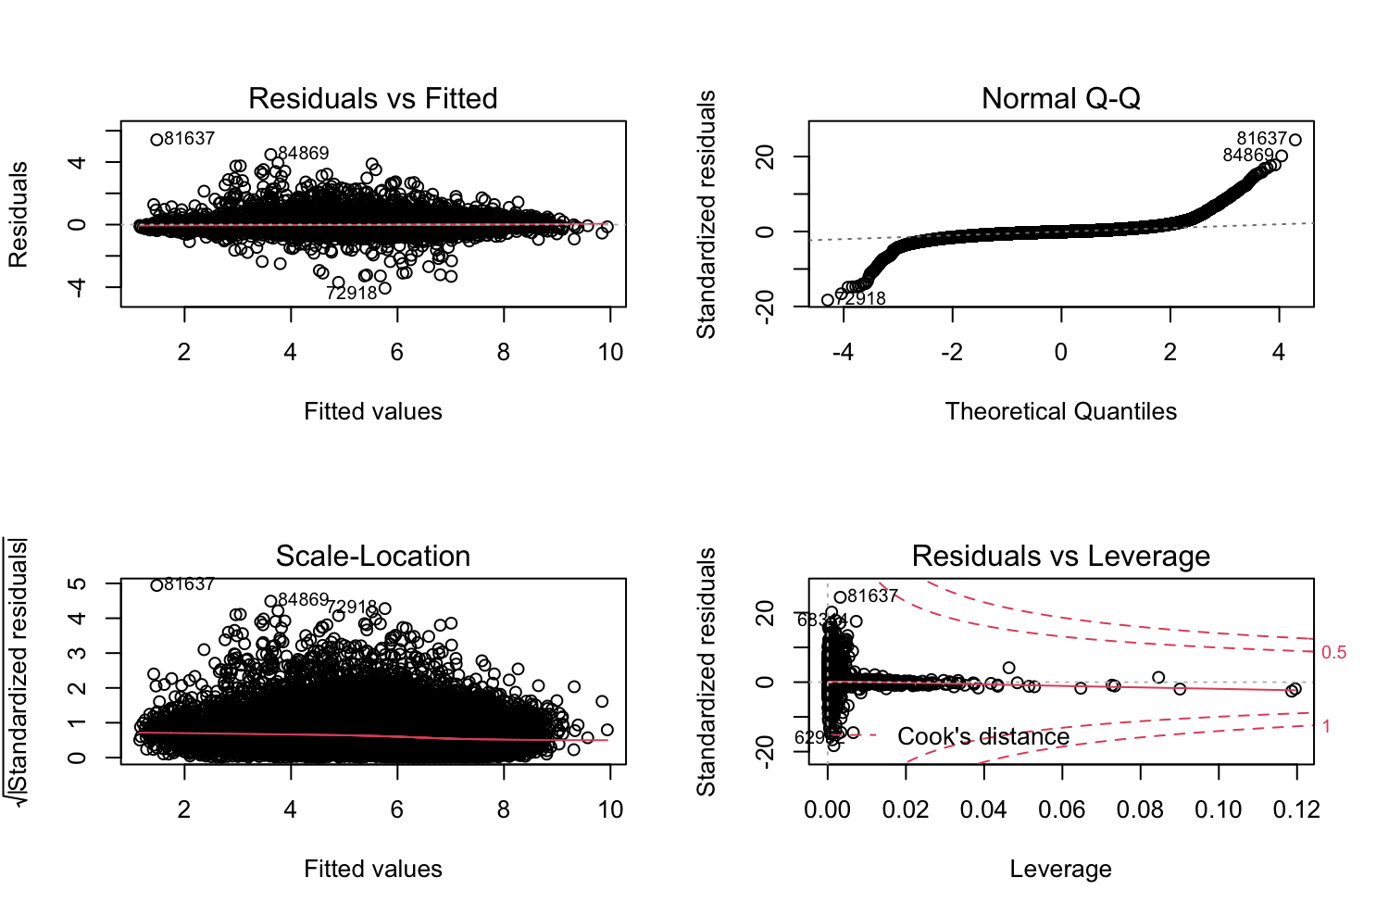
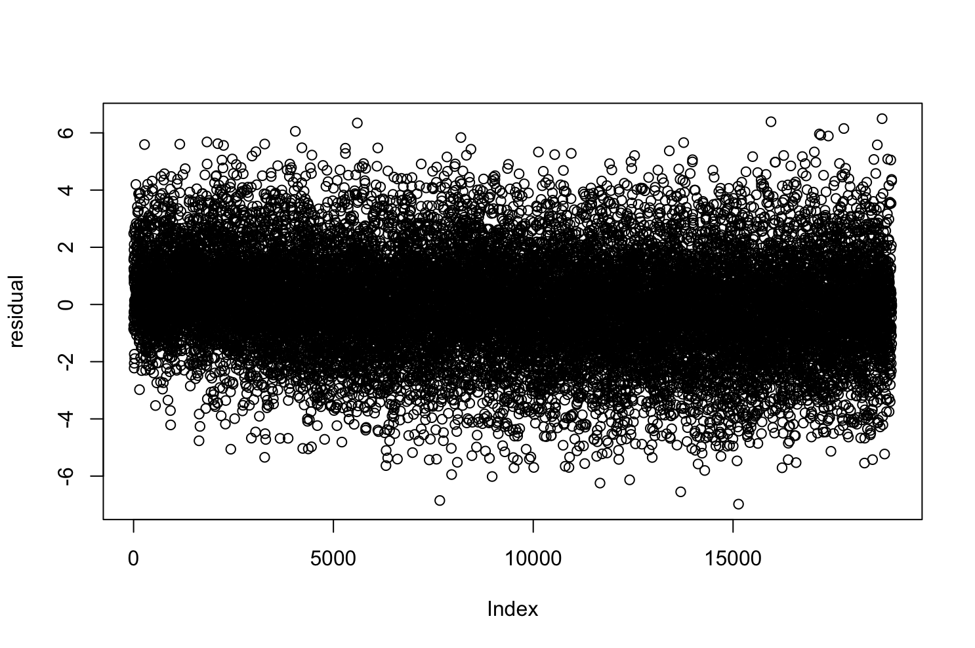
Predictive Models - Linear Regression
Mean value = 6.076049
RMSE = 0.2326479

Slide 17
Predictive Models - KNN
Scaled variables through preprocessing
Iterated through 100 different values of K
K = 14 produces best model
MSE at K = 14 is 0.90

Slide 18
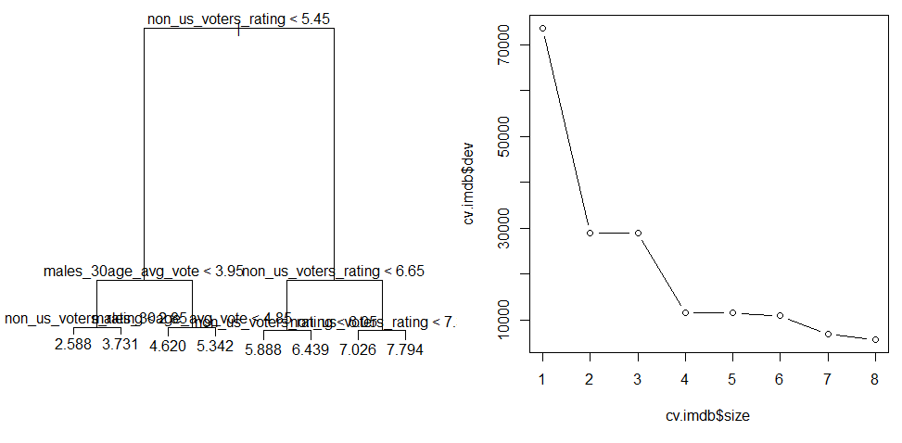
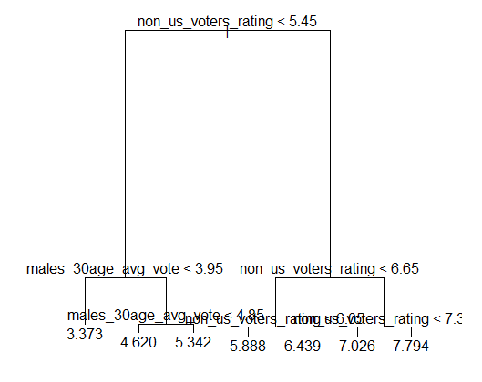
Predictive Models - Decision Tree
General Decision Tree
Mean Squared Error = 0.1171603
Pruned Decision Tree (Level = 7)
Mean Squared Error = 0.1385897

Slide 19
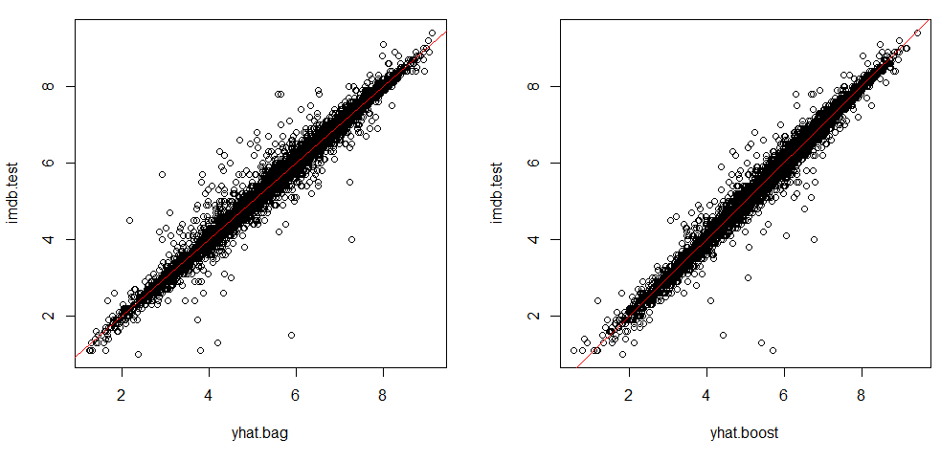
Predictive Models - Random Forest
Bagging (mtry=27 and ntree=25)
Mean Squared Error = 0.02758607
Boosting (n.trees=1000 and shrinkage=0.1)
Mean Squared Error = 0.02234654

Slide 20
Model Comparison
 | Mean Squared Error
Linear | 0.23
KNN (K=14) | 0.90
Decision Tree General | 0.11
Decision Tree Pruned | 0.13
Random Forest Bagging | 0.0275
Random Forest Boosting | 0.0223
MSE was the main criteria for model comparison
Bias-Variance tradeoff was considered an important factor
Random Forest with Bagging and Boosting produces best results

Slide 21
Conclusion
Predictive analytics can be incredibly useful in the entertainment industry
It is an important tool for understanding user behavior
Next course of action to improve prediction
Collection of more data
Inclusion of more features

Slide 22
Questions?

